Slide 1
3:20
June 15, 2012
Diagnostic Tool For STC-1XX
Exit Program
System Diagnostic Tool
Read Engine Parameters
Freeze Frame Data
Self-Test
System Status
Input/Output Test
Vehicle Information
DTC
Description
User Comments
P0068 | MAP – Throttle Position Correlaton | …..
P0125 | Insufficient Coolant Temp for Closed Loop Fuel Control
Read DTC Control
Clear DTC
Clearing..
Read
Save
Reset KAM
Finished

Slide 2
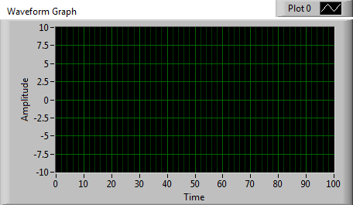
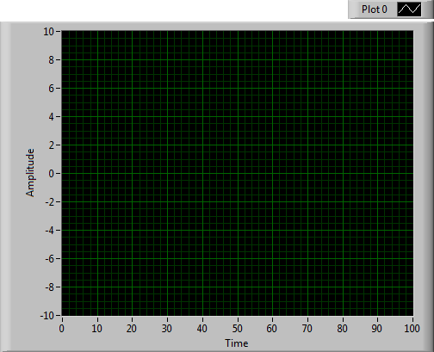
3:20
June 15, 2012
Diagnostic Tool For STC-1XX
Exit Program
System Diagnostic Tool
Read Engine Parameters
Freeze Frame Data
Self-Test
System Status
Input/Output Test
Vehicle Information
Distance Traveled on MIL (km)
Start Reading
Stop Reading
File Path
Short Term Fuel
Trim, Bank 1(%)
Calculated Load
Value (%)
Engine RPM
(min^-1)
Long Term Fuel
Trim, Bank 1(%)
Engine Coolant
Temp. (C)
Intake Air Temp.
(C)
Manifold Absolute
Pressure (kPa)
Vehicle Speed
Sensor (km/h)
Absolute Throttle
Position (%)
Ambient Air
Temp (C)
# of DTCs
Ignition Timing for
#1 Cylinder (C)

Slide 3
3:20
June 15, 2012
Diagnostic Tool For STC-1XX
Exit Program
System Diagnostic Tool
Read Engine Parameters
Freeze Frame Data
Self-Test
System Status
Input/Output Test
Vehicle Information
Read Freeze Frame Data
File Path
# of DTCs Stored by
Freeze Frame
Engine Coolant
Temperature
Engine RPM
Short Term Fuel Trim
Bank 1
Manifold Absolute
Pressure
Calculated Load
Value
Short Term Fuel
Trim, Bank 1(%)
Long Term Fuel Trim,
Bank 1
Fuel System Status
1

Slide 4
3:20
June 15, 2012
Diagnostic Tool For STC-1XX
Exit Program
System Diagnostic Tool
Read Engine Parameters
Freeze Frame Data
Self-Test
System Status
Input/Output Test
Vehicle Information
Start KOEO Test
Start KOER Test
Time Remaining
Abort
Abort
Finished
Finished
Message…
Message…

Slide 5
3:20
June 15, 2012
Diagnostic Tool For STC-1XX
Exit Program
System Diagnostic Tool
Read Engine Parameters
Freeze Frame Data
Self-Test
System Status
Input/Output Test
Vehicle Information
Check Status
PIP state is high |  | On
Dechocke mode flag |  | Off
A/C requested by driver |  | Off
MIL request on |  | On
A/C clutch commanded on |  | Off

Slide 6
3:20
June 15, 2012
Diagnostic Tool For STC-1XX
Exit Program
System Diagnostic Tool
Read Engine Parameters
Freeze Frame Data
Self-Test
System Status
Input/Output Test
Vehicle Information
HEGO sensor bank 1
Upstream heater state
High Speed
Fan
Fuel Pump
Fuel Inj. On for
INJON_TM
Fuel Inj. Off for
INJOFF_TM
MIL Output
A/C Relay
Idle Speed Control
Duty Cycle (%)
Target Lambda Value
Bank 1 (%)
Purge Canister
Solenoid (%)
Spark Angle Final
(degrees)

Slide 7
3:20
June 15, 2012
Diagnostic Tool For STC-1XX
Exit Program
System Diagnostic Tool
Read Engine Parameters
Freeze Frame Data
Self-Test
System Status
Input/Output Test
Vehicle Information
Vehicle Identification Number
Get Vehicle Information
Calibration ID
Calibration Verification Number

